Slide 1
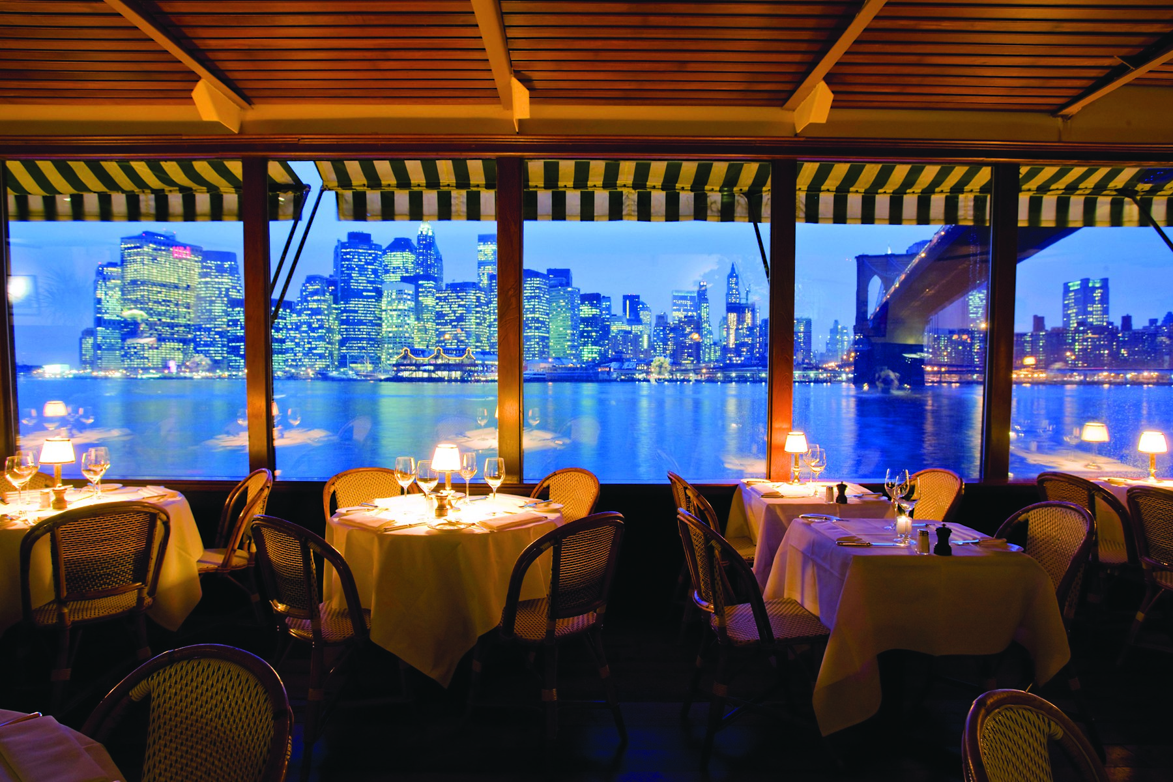
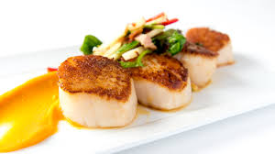


IBM Applied Data Science Capstone Project on NYC Restaurants Search
Project Presentation
Notes:
NOTE: To replace a picture, just select and delete it. Then use the Insert Picture icon to replace it with one of your own!

Slide 2
Content Lay-out
INTRODUCTION
DATA GATHERING
METHODOLOGY
RESULT
DISCUSSION
CONCLUSION

Slide 3
Introduction
In this project, I applied the algorithms to develop predictive models learned from the past courses in this IBM Data Science certification.
A Recommendation System to build a restaurant recommendation system that suggests the most suitable/popular neighborhoods for given type of cuisine/category by users.
This model can be used by the end users who are interested in finding neighborhoods for their preferred type of cuisines.

Slide 4
Data Gathering
The dataset that I am going to use for this project is available free on the web. Here is the link to the dataset: https://geo.nyu.edu/catalog/nyu_2451_34572
Following features are extracted from the downloaded json file -
NY city Borough
Neighborhood
Latitude and Longitude coordinates.
Foursquare location data is used to run a query on it for the required type of cuisine/category by the user. And following fields are extracted –
Venue Name
Venue Category
Venue location Latitude and Longitude coordinate.

Slide 5
METHODOLOGY
The data downloaded in json format contains the all the required data for the analysis was in the ‘feature key’ of the json file.
All the required data for the analysis was in the ‘feature key’ of the json file Third bullet point here.
Data Gathering
Data Understanding
Data Preprocessing
Analysis of Data
Modeling
Evaluation
Feedback

Slide 6
Methodology contd..
Used Foursquare API to get the information about different venues.
Foursquare API provides location based experiences with diverse information about venues, users, photos, and check-ins.
All of the information which is relevant to my analysis is in the ‘item’ key of the foursquare json file.
Using the get request command I extracted the required fields and converted them into python data frame for easy manipulation and analysis.
Using Foursquare API and kmeans clustering I found the neighborhoods for the given type of cuisine.

Slide 7
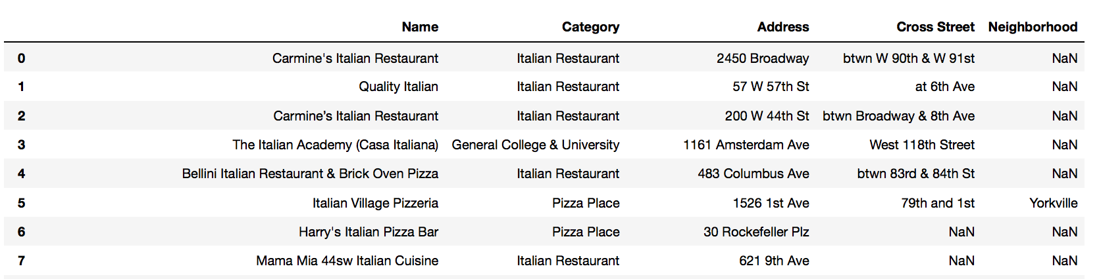
Results
Following figure 1 and 2 shows the result table and the map showing the restaurants.
For easy access of the location, I also extracted the cross street information for user because the neighborhood information is not present in the data which is extracted from the foursquare API.
Figure 1

Slide 8
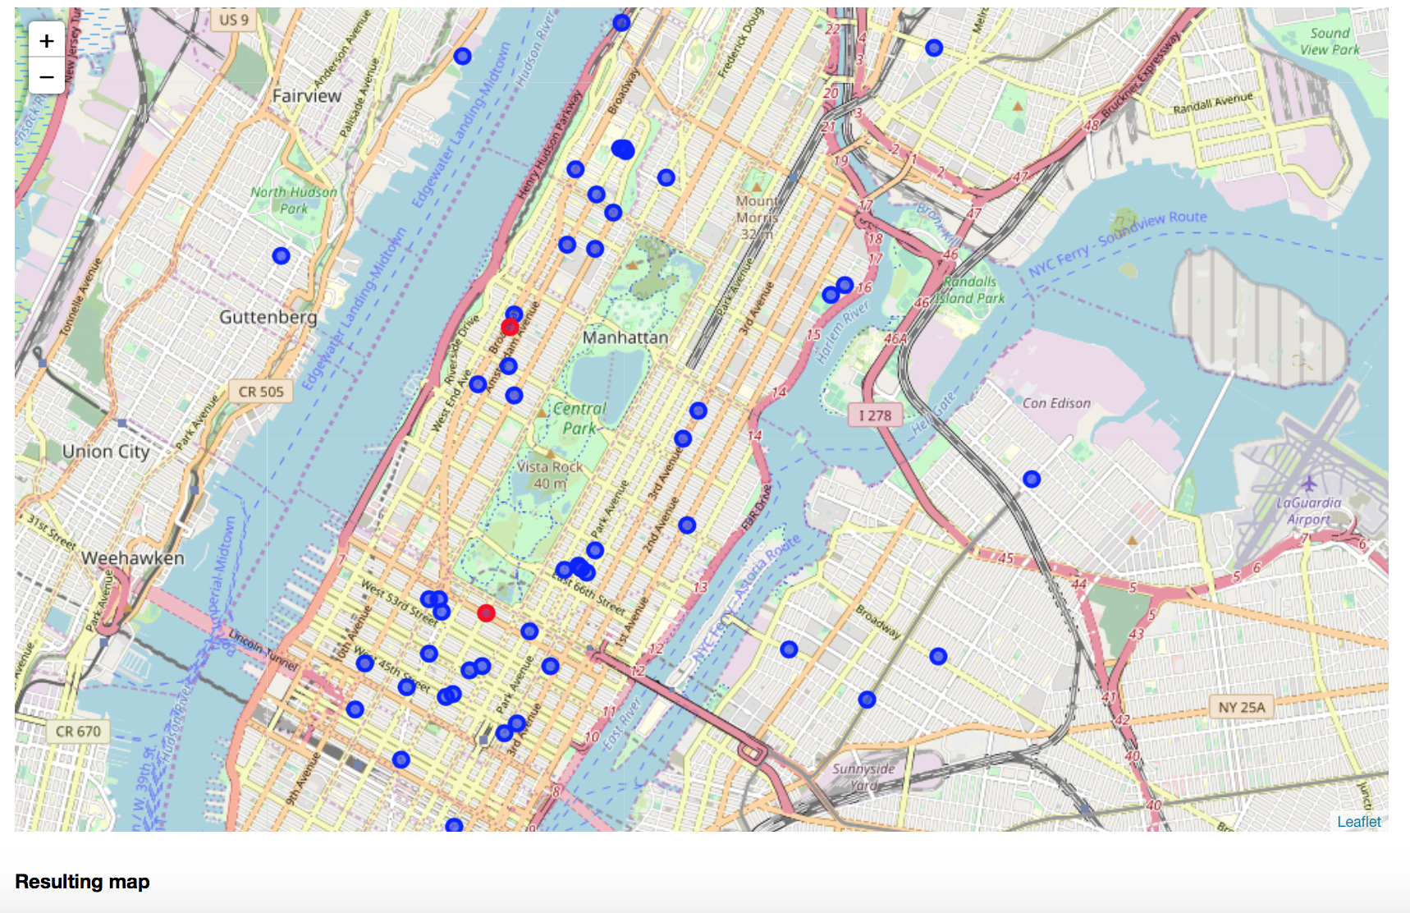
Results contd…

Slide 9
Conclusion
Designing this system was a very useful exercise and I believe that the literature survey I have done was very useful for me in order to understand the logic behind the recommendation systems.
Implementing such a project demonstrated how a knowledge based system can actually encapsulate knowledge.
It also showed the limitations of knowledge based systems and the assumptions that must be made when designing them.

Slide 10
Thank you!

